Slide 1
Machine Learning Methods for Population Genomic Inference
Dan Schrider

Slide 2
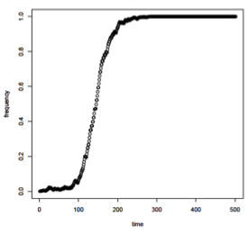
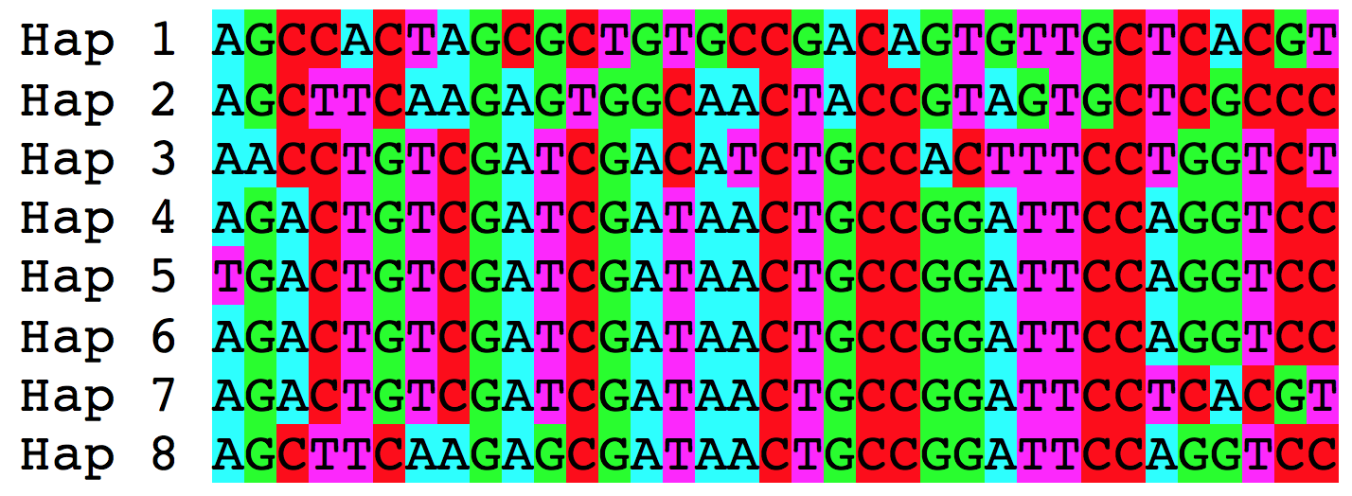
Population genetic inference
Evolutionary Phenomenon
Altered genealogy
Sequence alignment

Slide 3
Going in reverse
Infer presence of phenomenon of interest
Sweep or no?
Capture properties of genealogy with test/statistc
e.g. π, iHS
Sequence alignment

Slide 4
Summarizing patterns of diversity
There is a rich tradition (and literature) of developing problem-specific statistics for summarizing patterns of genetic variation from sequence data
Often the behavior of these statistics under theoretical models are well characterized (analytically and/or via simulation)
Let’s talk about one of them

Slide 5
π (nucleotide diversity)
π: Average pairwise diversity
If we grab two random chromosomes, how likely are they to be a heterozygote?
Can be measured at one site or averaged/summed across sites
Intimately connected to several key population genetic models/processes
But not very useful for inference, on its own…
where n=sample size
π_{i,j}=the fraction of sites that differ between sequences i and j.
Nei and Li (1979)

Slide 6

Capturing information in the alignment with summary statistics
or:
π
More statistics → more information about the genealogy → more power!
Pavlidis et al. (2010), Lin et al. (2011), Ronen et al. (2013)
Pudlo et al. (2014), Pybus et al. (2015), Schrider and Kern (2016)

Slide 7
Machine learning is well suited for this
f(x) = y; x is our observation and y is our response variable (e.g. a demographic model)
we wish to learn f from a training set <x, y>
machine learning can excel when x is high-dimensional (i.e. has large # of features)
Some methods can handle multi-dimensional y as well (e.g. a vector of model parameters).

Slide 8
Outline
Detecting sweeps with machine learning
Demographic inference
Recombination rate estimation
Detecting introgression
Population genetic inference with machine learning without summary statistics

Slide 9
Part 1
Detecting sweeps with machine learning
Demographic inference
Recombination rate estimation
Detecting introgression
Population genetic inference with machine learning without summary statistics

Slide 10

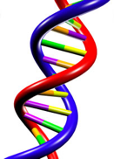
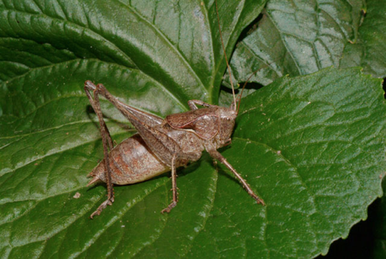
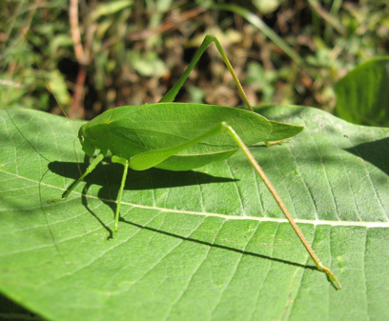
Positive selection
mutation + selection

Slide 11
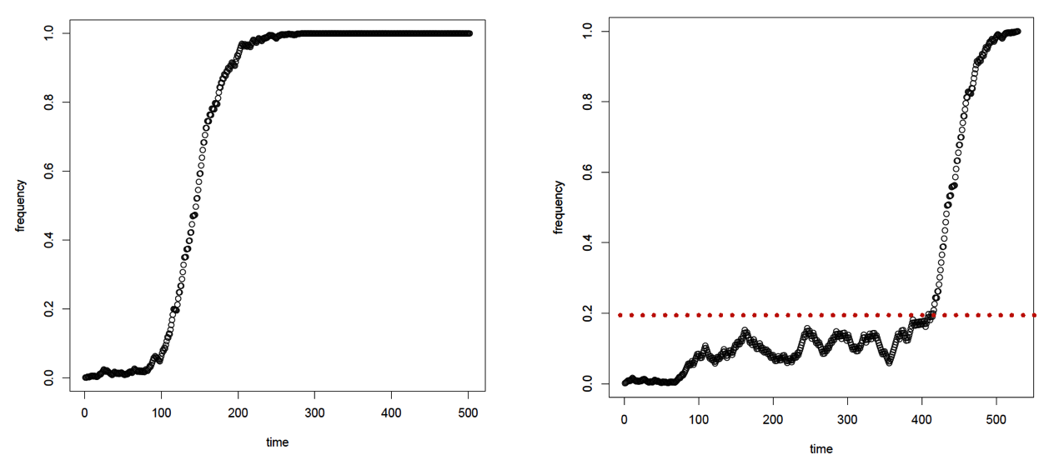
Two ways a population could respond:
Change in environment
Selection on de novo mutation
“Hard Sweep”
Selection on standing variation
“Soft Sweep”
These models produce quantitatively and qualitatively different effects on spatial patterns of variation.

Slide 12
Sweeps skew the site frequency spectrum (SFS)
Fraction of polymorphisms

Slide 13
SFSelect
Premise: instead of using a single stat, let’s use the SFS measured in a genomic window
-- Feature vector: the values in each bin of the SFS
Need a training set: simulate a bunch of sweeps and measure the SFS!
Train a support vector machine (SVM), and apply to the genome
Ronen et al. (2013)

Slide 14
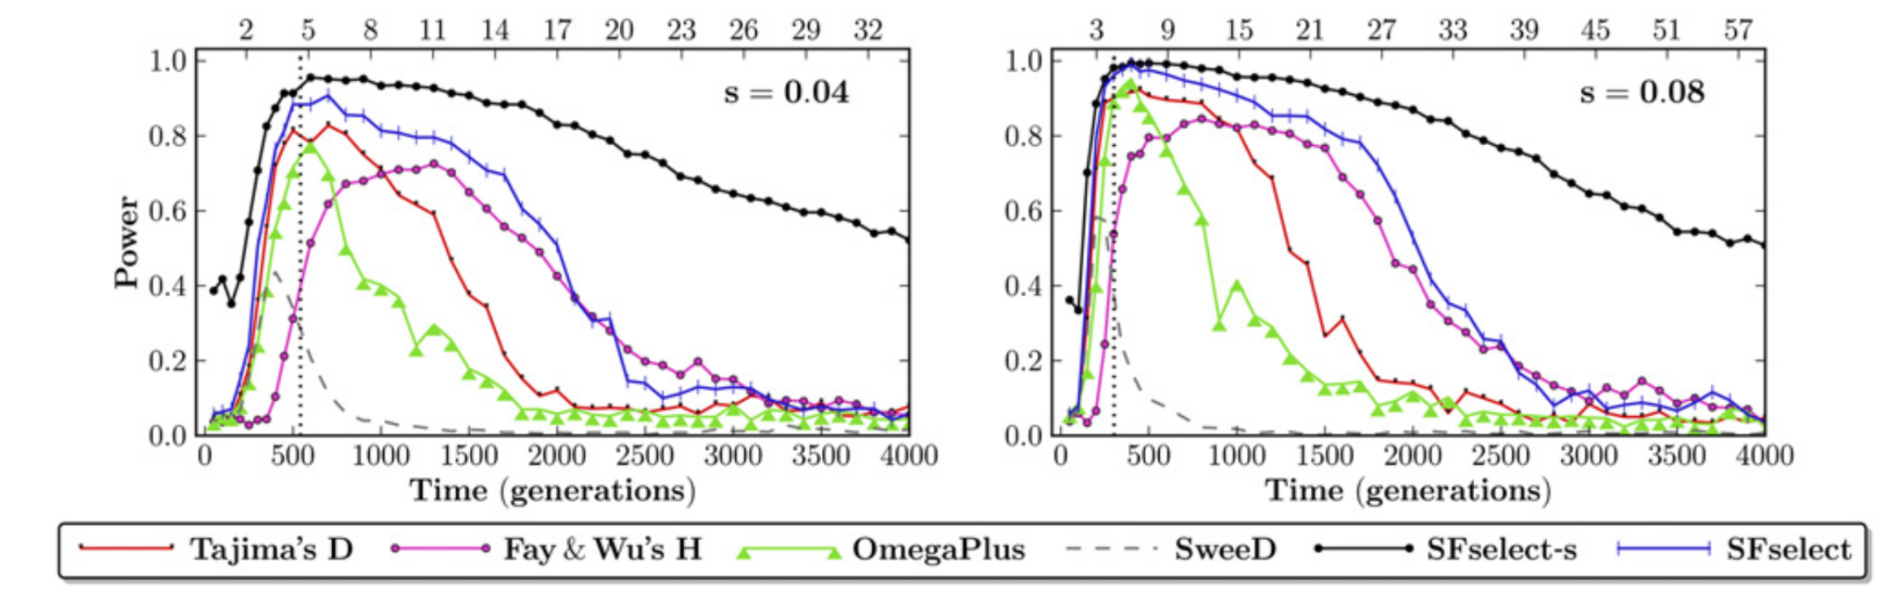
SFSelect is pretty powerful!
Ronen et al. (2013)

Slide 15
SFSelect is not spatially aware
Regions closely linked to sweeps will be misclassified as sweeps: harder to narrow down the signature of selection.
Neutral
Sweep
Neutral
What we get:
Sweep site
Neutral
Linked to sweep
Sweep
Linked to sweep
Neutral
What we want:
Sweep site

Slide 16
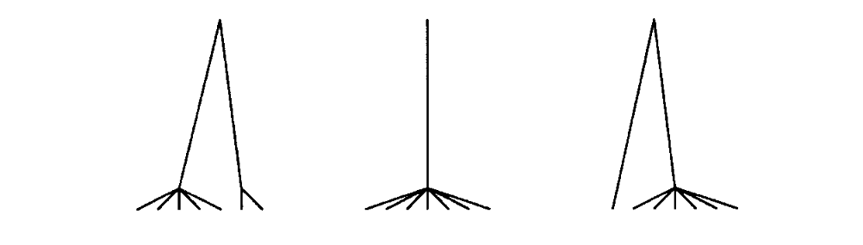
SFSelect is not spatially aware
Neutral
Linked to sweep
Sweep
Linked to sweep
Neutral
Sweep site

Slide 17
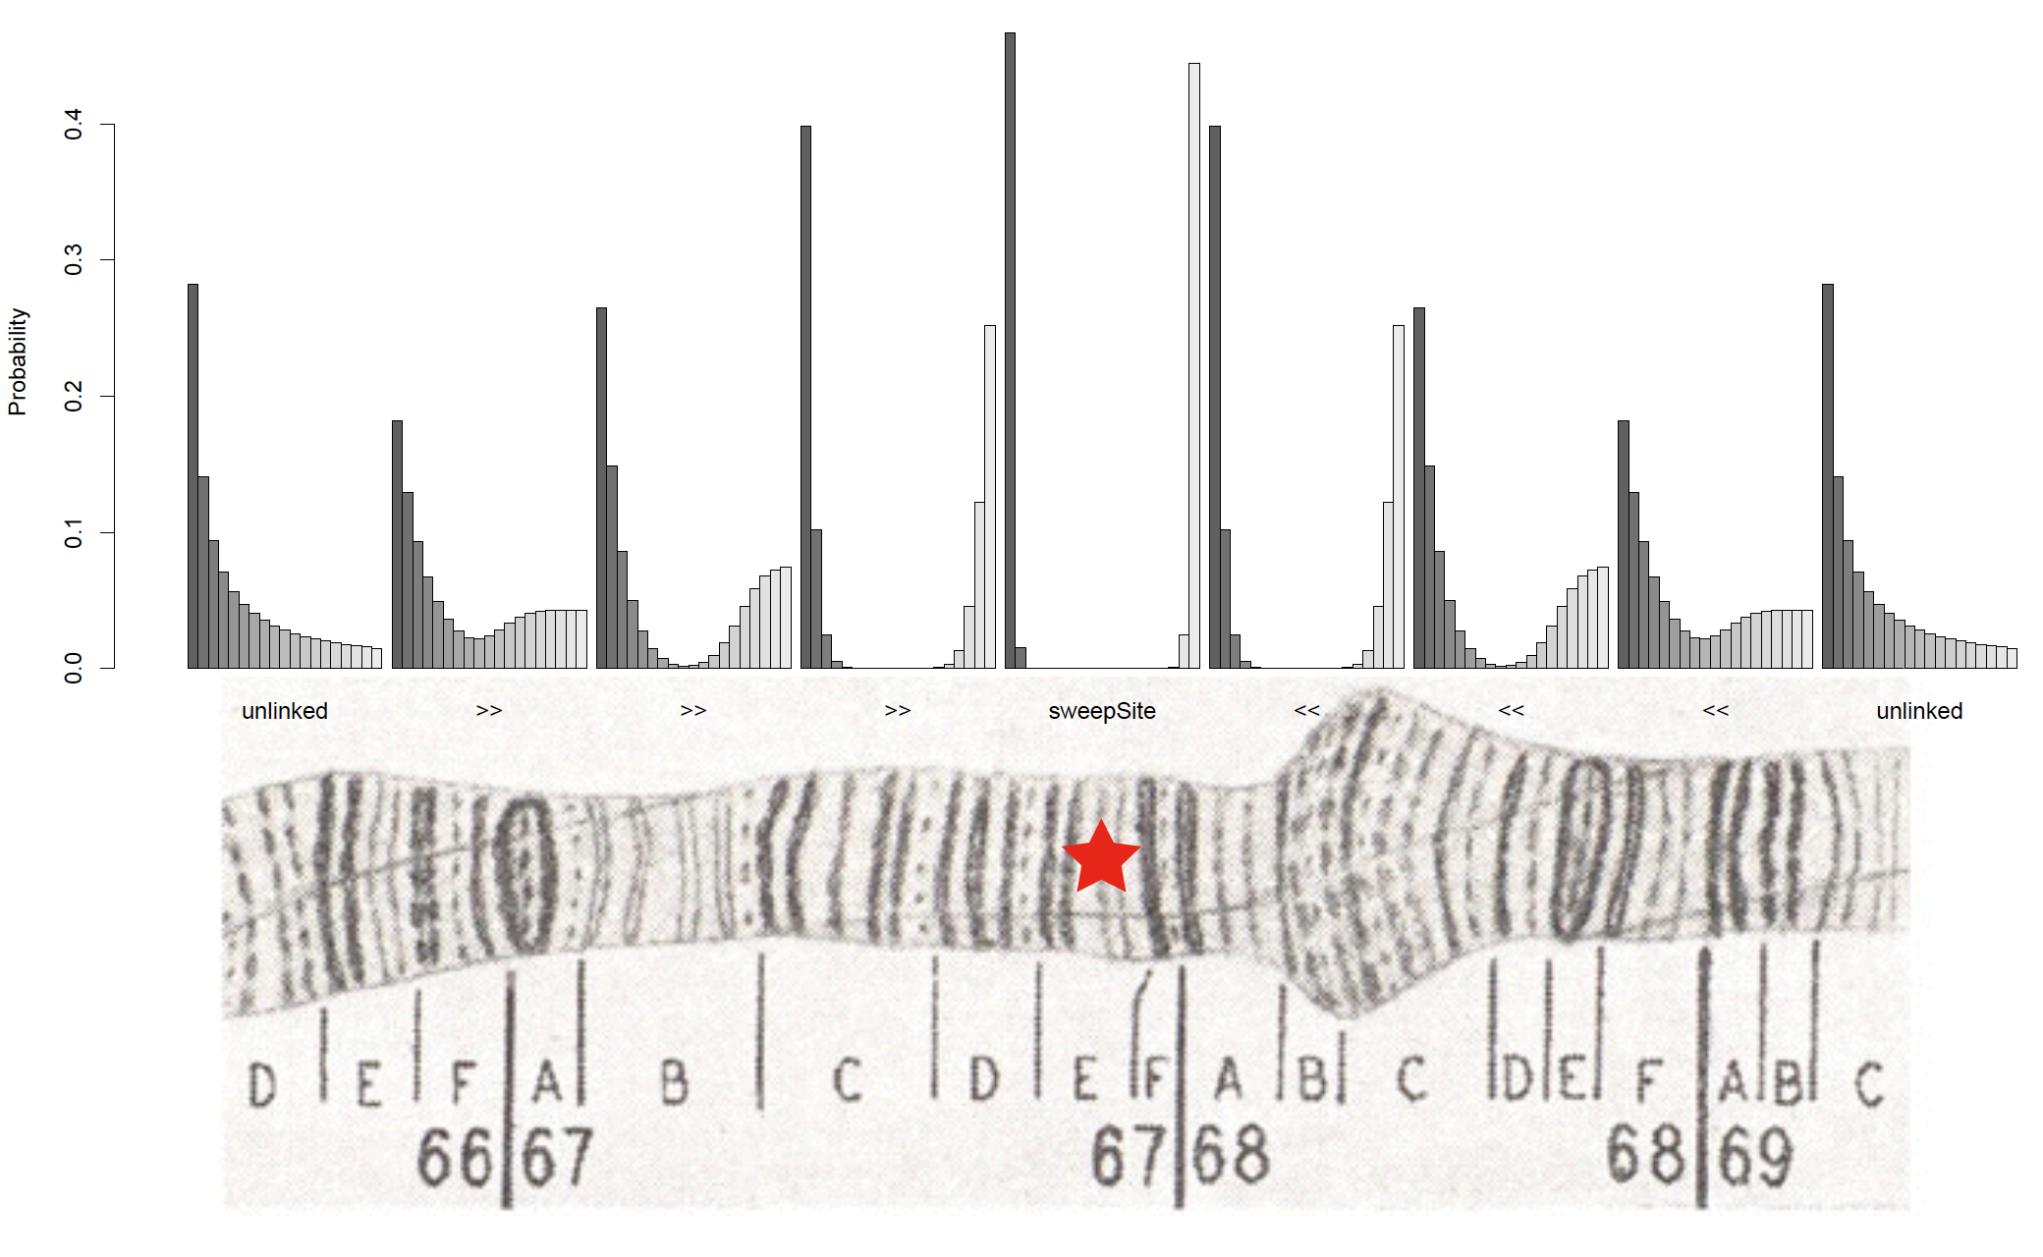

Slide 18
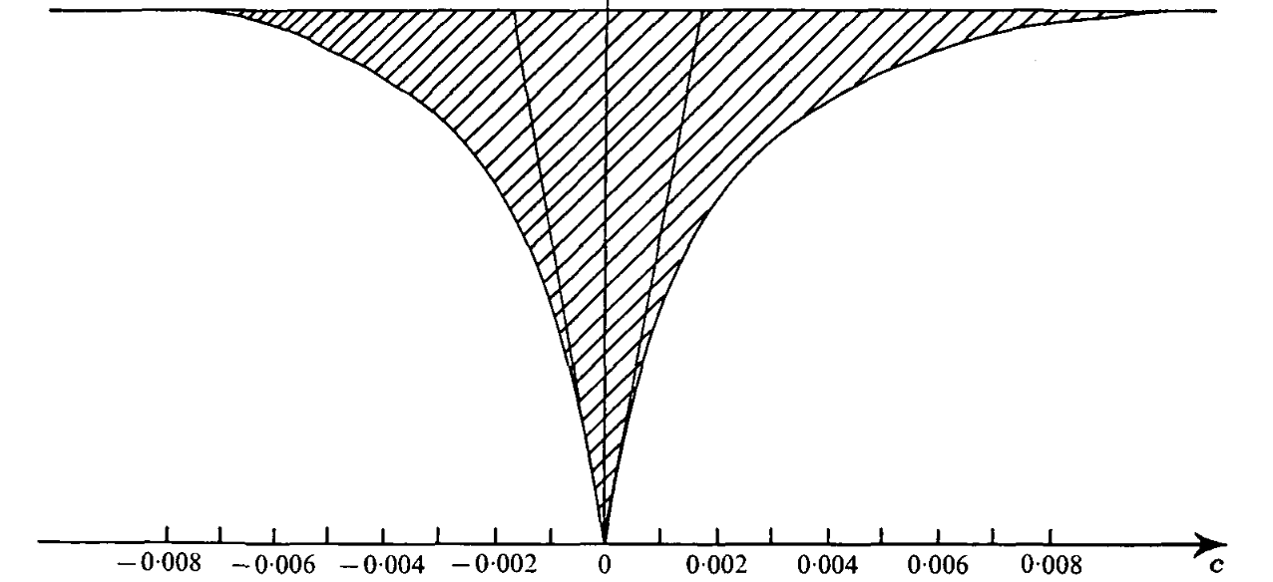
Sweeps create a valley of diversity
Maynard Smith and Haigh (1974)

Slide 19
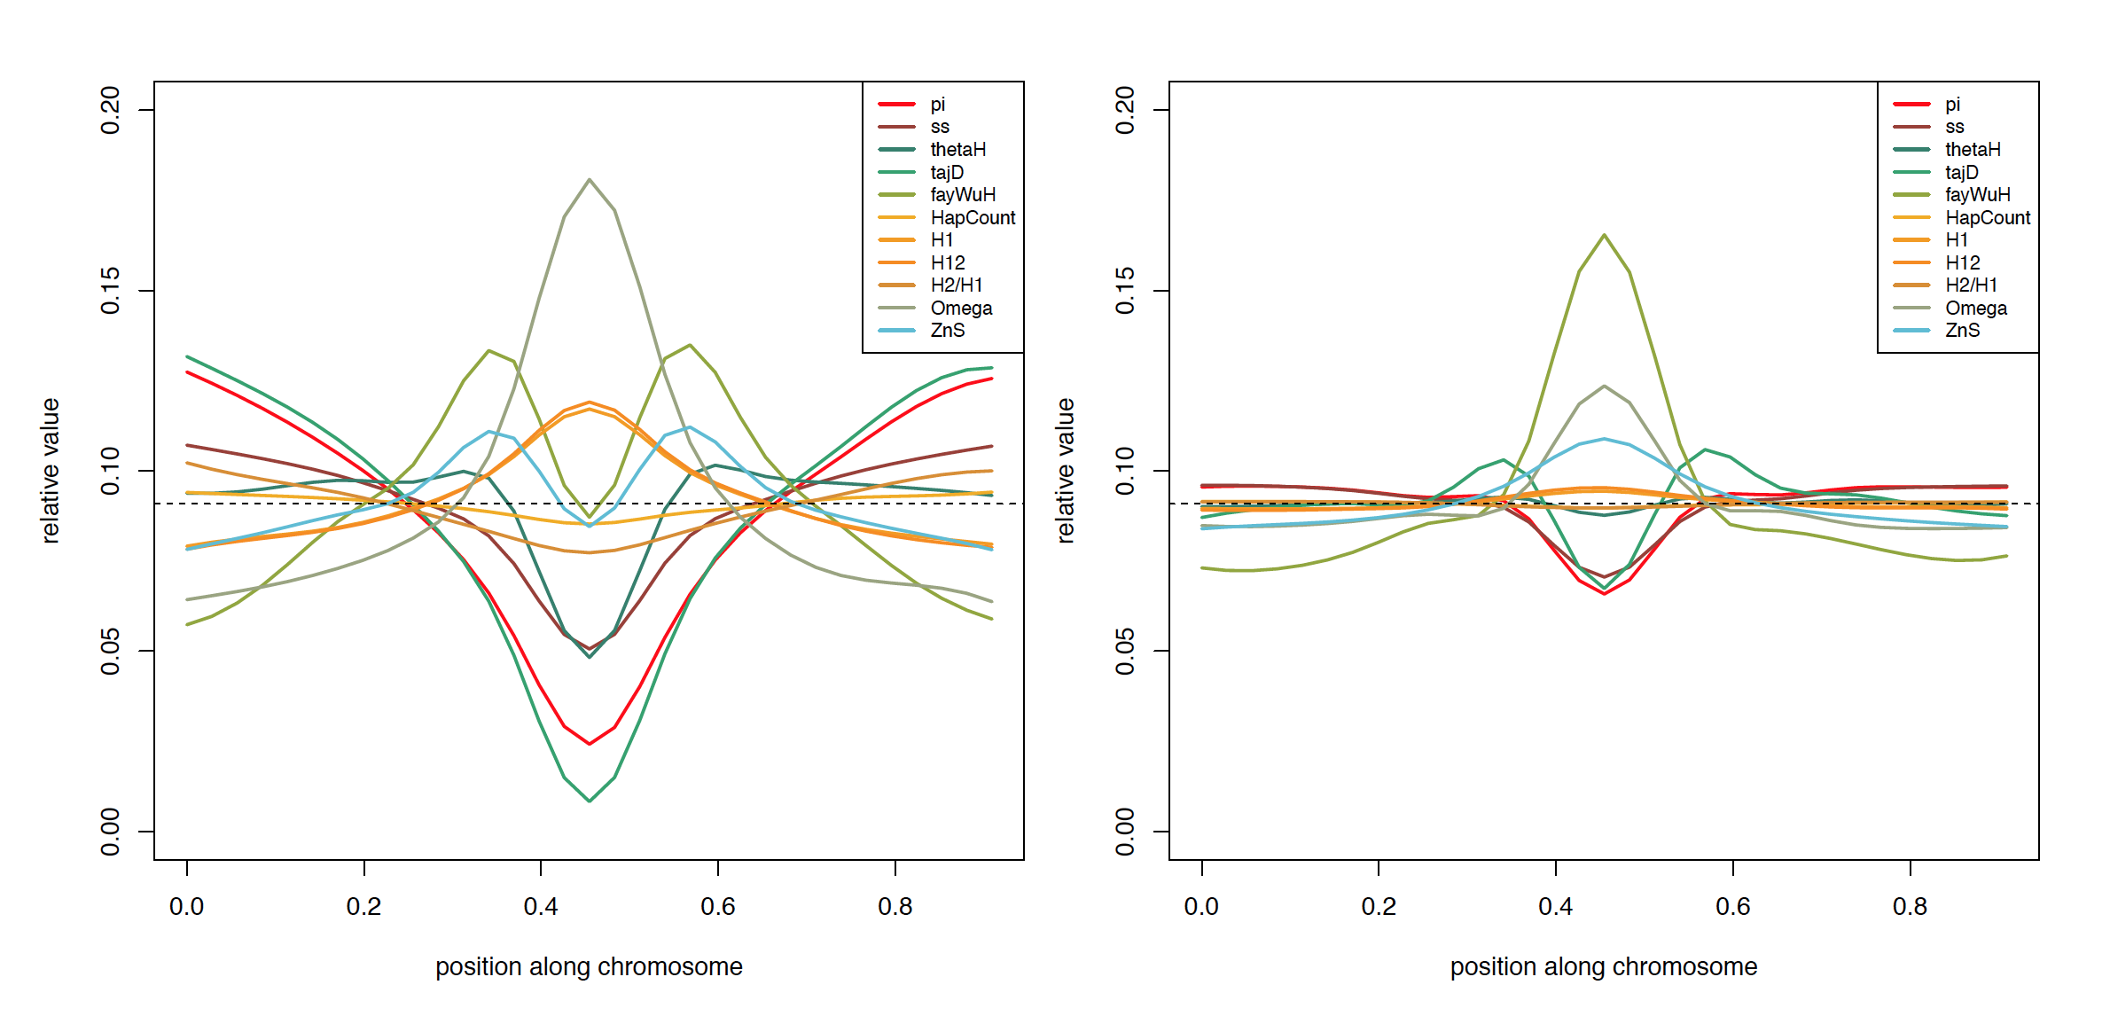
Multi-dimensional spatial patterns of variation around sweeps
Hard Sweep
Soft Sweep

Slide 20
Alternative approach: zoom out, examine neighborhood
Sweep site
Chromosomal position

Slide 21
Spatially aware methods
evolBoosting: Tajima’s D, Fay and Wu’s H, and their components, and iHH
S/HIC: π, Tajima’s D, Fay and Wu’s H, the number of distinct haplotypes, average haplotype homozygosity, average r², Kim and Nielsen’s ω, etc
Trendsetter: π, avg r², # of distinct haplotypes, and the H₁₂ family of statistics (Garud et al. 2015)
Note: rather than calculating these in medium-sized subwindows: Trendsetter uses trend-filtered regression.

Slide 22
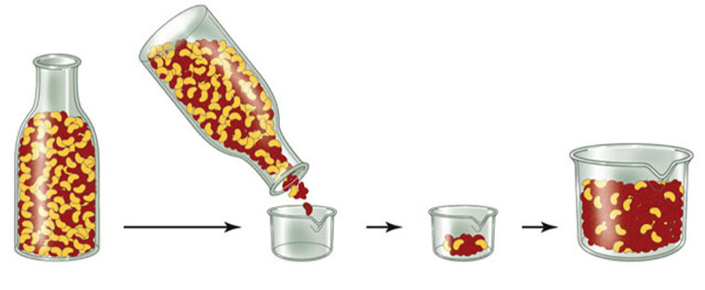
Bottlenecks may resemble sweeps
Out of Africa bottleneck ~51 kya
Population size
Population growth ~23 kya
75 kya
Time
Present day
Gravel et al. (2011)

Slide 23
Strengths and weaknesses of spatially aware methods
Higher resolution and greater robustness to demography
Complete robustness to background selection (Schrider and Kern 2017; Mughal and DeGiorgio 2018)
Weaknesses: none.
(okay, a larger feature vector can be more computationally intensive to deal with but who cares?)

Slide 24
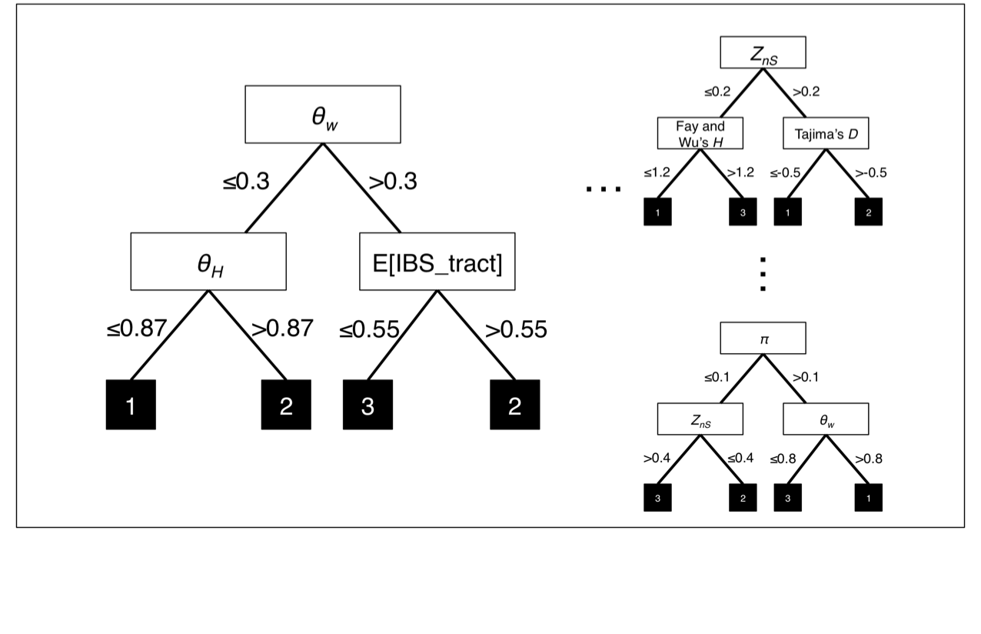
S/HIC’s: Soft/Hard Inference via Classification
S/HIC uses an RF variant called an Extra-Trees Classifier

Slide 25
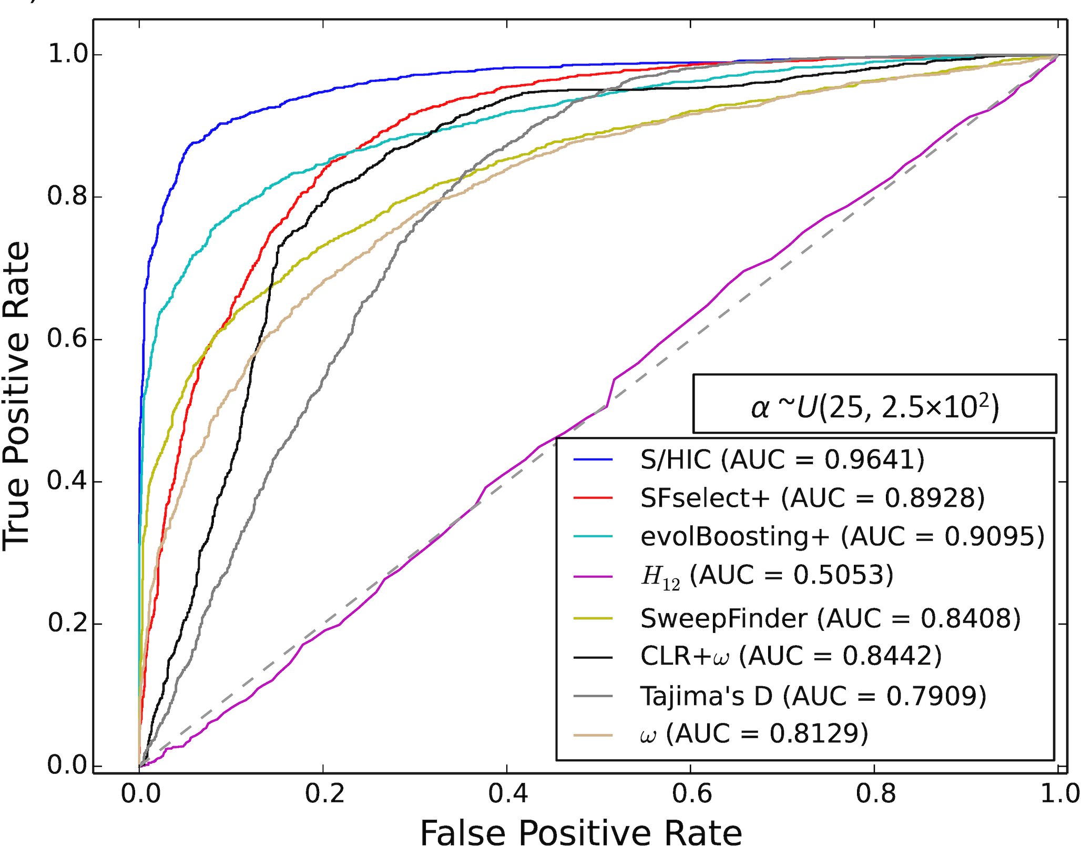
Power on simulated data
Note: the top methods on this data set are all machine learning approaches
(Trendsetter not shown, but does as well as S/HIC)

Slide 26
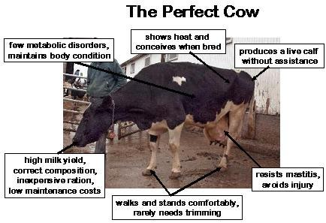
Soft sweeps may be common
Quantitative Geneticists’ view of selection:
R=h²S
Also, recent population genetic evidence (e.g. Hermisson and Pennings 2005; Pennings and Hermisson 2006a; 2006b)

Slide 27
Machine learning methods are readily extended to handle soft sweeps
Built-in:
S/HIC
Trendsetter
Trivially extended:
evolBoosting
SFSelect
SWIF(r)
Several ways to extend binary classifiers to handle more classes (e.g. hierarchical classification: sweep vs. neutral; then hard vs. soft)

Slide 28
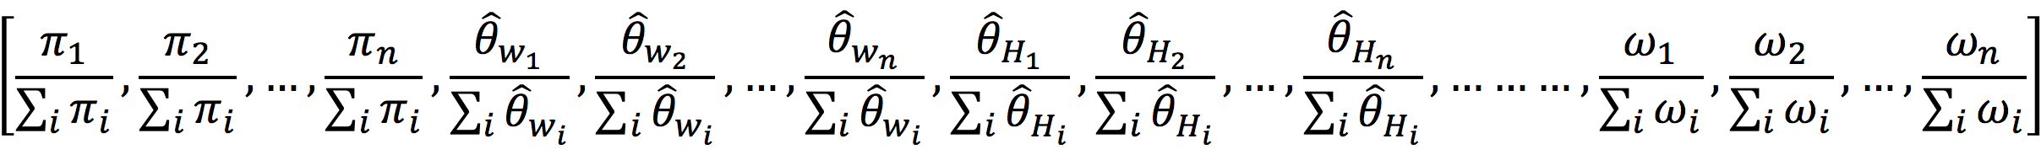
So why bother with machine learning?
Consider the S/HIC feature vector which has over 100 features (and growing!):
ABC will suffer from the Curse of Dimensionality in this case.
Modern machine learning algorithms are not so troubled by this. Indeed, they are designed for large, high dimensional datasets (and sometimes used solely for dimensionality reduction).

Slide 29
Traditional machine learning versus weird pop gen machine learning
Typical machine learning: train and test on real dataset before applying to some other real dataset
--perhaps some confidence that training/test data are distributed somewhat similarly to the application data set
Weird pop gen machine learning: train and test on simulated data before applying to real data
--perhaps you can hope that the training/test data are distributed somewhat similarly to the real data set, if you are careful enough in designing your simulations…

Slide 30
Summary (part 1 – sweeps)
Detecting sweeps is a difficult problem
By allowing us to capture more aspects of the input data, machine learning methods can help improve our power.
Some methods may suffer in the case of model misspecification: need to simulate lots of test data to find out!

Slide 31
Part 2
Detecting sweeps with machine learning
Demographic inference
Recombination rate estimation
Detecting introgression
Population genetic inference with machine learning without summary statistics

Slide 32
Why do we care about inferring demographic histories?
1) Because it’s interesting.

Slide 33
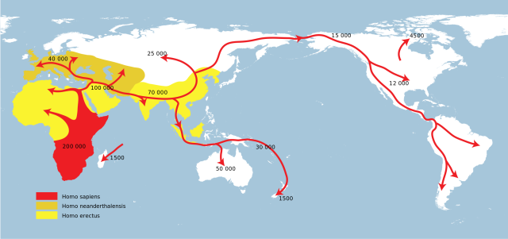
Human migration history
Genetic data complement the archaeological record

Slide 34
Why do we care about inferring demographic histories?
Because it’s interesting.
We need an appropriate null model for detecting selection.

Slide 35
Population size change vs. sweeps
Smaller N
Large N

Slide 36
Evidence of selection?
Compared to what?

Slide 37
How do we do this?
Assumption: natural selection affects patterns of polymorphism across only a small part of the genome.
Use genome-wide patterns of variation to estimate demographic parameters.
Can also perform model selection.

Slide 38
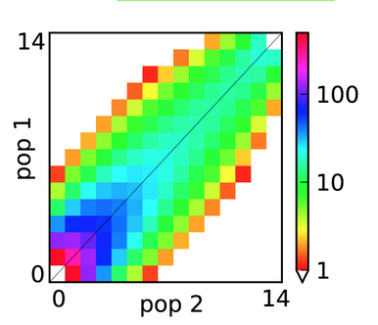
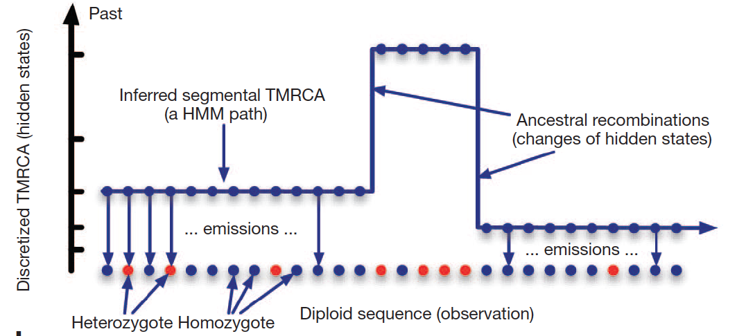
Multiple approaches for demographic inference
dadi: likelihood of joint SFS under a demographic model
PSMC/MSMC/SMC++: distribution of coalescence times of a sample
Let’s talk about a third way: Approximate Bayesian Computation (ABC)

Slide 39
In pop gen, ABC predates ML in combining summary statistics
∝ # of segregating sites
Tajima’s D: excess/deficit of intermediate freqs?
π: average number of pairwise differences
Fay and Wu’s H: Excess of high freqs?
r²: correlation of alleles across linked loci
F_{ST}: differentiation between populations

Slide 40
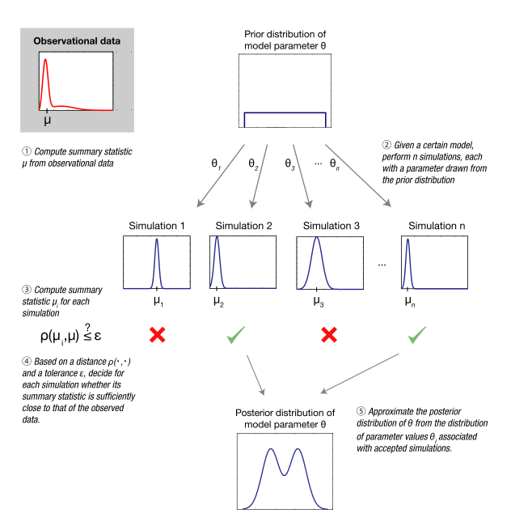
Approximate Bayesian Computation (ABC)
Simulate under a variety of parameter values
Summary statistic from real data set.
Which simulations “look like” our real data?
Estimate posterior probability distribution of model params from these “accepted simulations”
Sunnåker et al. (2013)

Slide 41
Strengths and limitations of ABC
Benefits of ABC:
flexibility: if you can simulate it and summarize it, then you can do inference (in principle)!
produces posterior density
Weaknesses:
you typically need a lot of simulations
for every prediction we have to examine entire training set
What about machine learning?

Slide 42
abcrf’s approach to demographic model selection
acbrf is just a Random Forest

Slide 43
abcrf beats ABC, and does it with fewer simulations
Method | Error with 10,000 training examples | Error with 20,000 training examples | Error with 50,000 training examples
ABC | 57.46% | 53.76% | 51.03%
abcrf | 40.18% | 38.94% | 37.63%
Pudlo et al. (2016)

Slide 44
Random Forest Regressor
Feature 2
Feature 1
≤0.22
>0.78
Feature 5
Feature 7
…
≤0.33
>0.67
≤0.6
>0.4
≤0.1
>0.9
16, 17
40, 50, 55
31, 57
3, 20, 27
Feature 2
Feature 3
…
≤0.13
>0.87
≤0.45
>0.55
Feature 2
≤0.9
>0.1
16, 17, 20, 27
3
31, 40
50, 55, 57
Feature 5
Feature 7
≤0.61
>0.39
≤0.15
>0.85
55, 57
50
3, 16, 17
20, 27, 31, 40

Slide 45
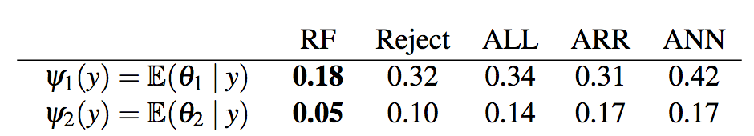
Parameter inference with abcrf
results on toy example, compared to various flavors of ABC:
Mean error for param 1:
Mean error for param 2:
Promising, but probably needs more testing…
Raynal et al. (2017)

Slide 46
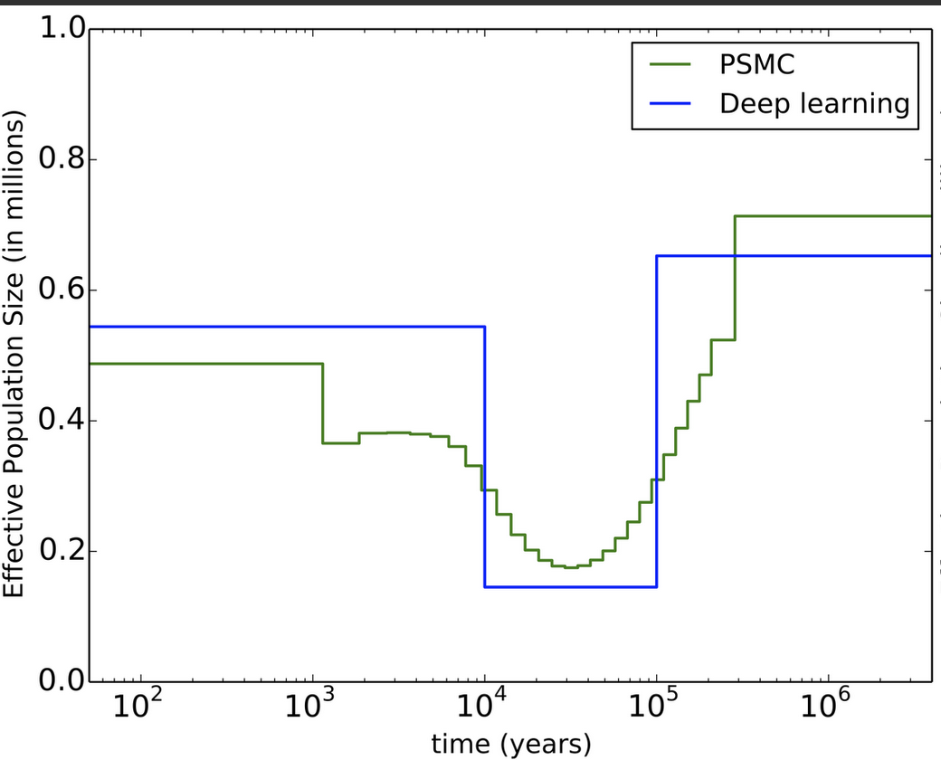
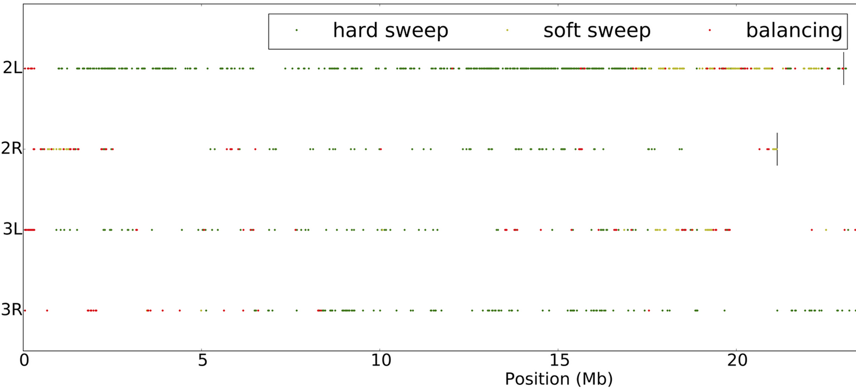
Co-estimation of demography and selective sweeps
These two phenomena both confound efforts to make inferences about the other.
Thus, co-estimation may be the most important outstanding problem in population genetics.
ML is one way to tackle it.
first real attempt: Sheehan and Song (2016)

Slide 47
Summary – demographic inference
Machine learning approaches are well suited for demographic inference (natural alternative to ABC)
Has only just begun to be exploited.

Slide 48
Part 3
Detecting sweeps with machine learning
Demographic inference
Recombination rate estimation
Detecting introgression
Population genetic inference with machine learning without summary statistics

Slide 49
Evolution at two linked loci
Haplotype
Frequency
x₁
A₁
B₁
r
x₂
A₁
B₂
A
B
x₃
A₂
B₁
x₄
A₂
B₂
How does recombination alter the frequency of these haplotypes?

Slide 50
Change in haplotype frequency
x₁ = Freq(A₁B₁), p₁ = Freq(A₁), p₂ = Freq(B₁)
…recombinant haplotypes are random pairs of alleles
x’₁ = (1 – r) x₁ + rp₁p₂
Δ_{r}x₁ = (1 – r) x₁ + rp₁p₂ – x₁
= –rx₁ + rp₁p₂
= –r(x₁ – p₁p₂)
…eventually, x₁ = p₁p₂

Slide 51
Change in haplotype frequency
x₁ = Freq(A₁B₁), p₁ = Freq(A₁), p₂ = Freq(B₁)
…recombinant haplotypes are random pairs of alleles
x’₁ = (1 – r) x₁ + rp₁p₂
Δ_{r}x₁ = (1 – r) x₁ + rp₁p₂ – x₁
= –rx₁ + rp₁p₂
= –r(x₁ – p₁p₂)
D = x₁ – p₁p₂
Δ_{r}x₁ = –rD
…eventually, x₁ = p₁p₂
D: coefficient of disequilibrium
Linkage disequilibrium: pairs of alleles are occur together more/less often than expected under random assortment

Slide 52
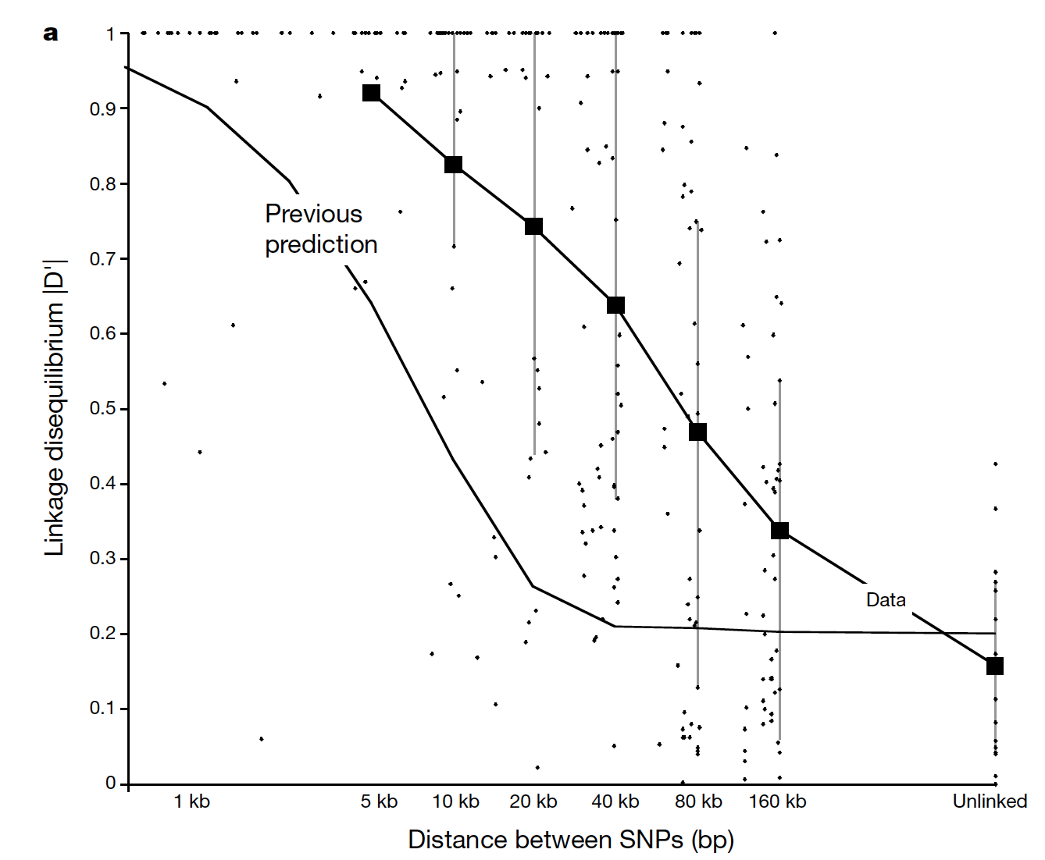
LD decays with distance
r
A
B
Δ_{r}x₁ = –rD
r increases with physical distance between the two sites

Slide 53
FastEPRR: estimate ρ=4Nr via boosting
We wish to calculate ρ in a window of fixed size.
First, in each window calculate each of the following:
Mean value of S_{k}² (Hudson 1987)
Mean r² for all pairs of SNPs in the window
Mean haplotype homozygosity
The number of distinct haplotypes
Simulate a training set, and train a regressor via boosting
Lin et al. (2013), Gao et al. (2016)

Slide 54
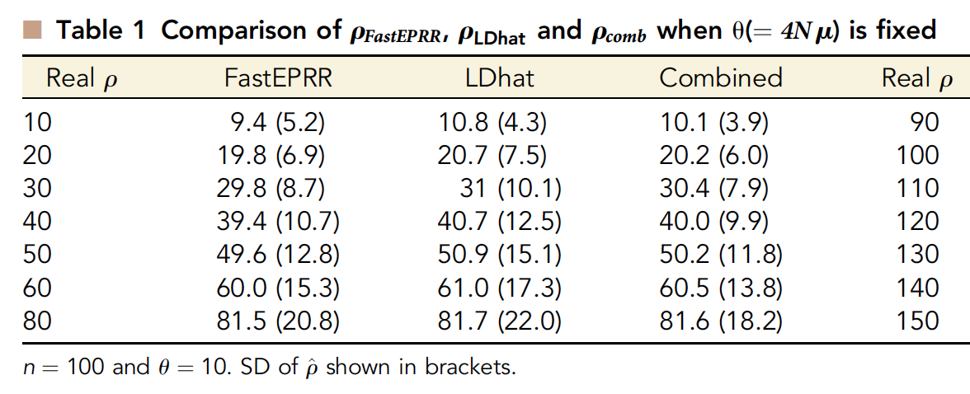
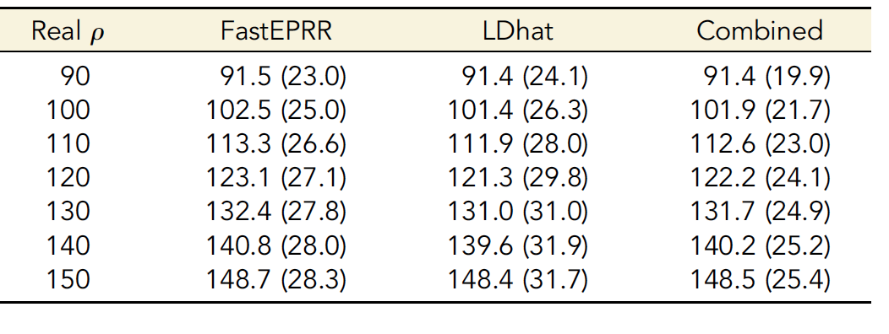
Similar accuracy to LDhat
Gao et al. (2016)

Slide 55
Advantages of FastEPPR
FastEPRR can naturally handle missing data
--Simply incorporate into your training simulations
FastEPRR can use much larger sample sizes:
--Full 1KG data set on single core:
~3d for FastEPR
years for LDhat
Larger sample size -> higher accuracy.

Slide 56
Summary (recomb rate)
FastEPRR is pretty impressive (accurate and fast)
But still only using a fairly low-dimensional summary of the data. We can probably do even better!

Slide 57
Part 4
Detecting sweeps with machine learning
Demographic inference
Recombination rate estimation
Detecting introgression
Population genetic inference with machine learning without summary statistics

Slide 58



Detecting introgression
vs.

Slide 59

Speciation with gene flow
a
b
a
b
A
b
a
B
A
b
a
B
A
b
a
B

Slide 60
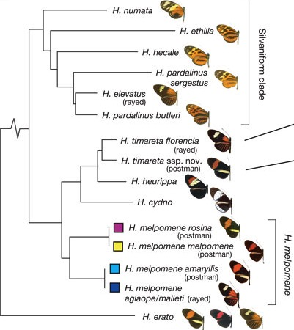
Adaptive introgression in Heliconius
Gene flow at mimicry loci
Heliconius Genome Consortium (2012)

Slide 61
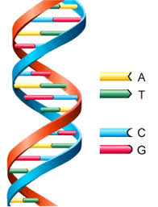
Detecting introgression
vs.

Slide 62
Detecting introgression
Geneva et al. (2015); Rosenzweig et al. (2016)

Slide 63
Detecting introgression
G_{min} =
d_{min} ⁄d_{mean}
RND_{min} =
d_{min} ⁄d_{out}
d_{min}
Geneva et al. (2015); Rosenzweig et al. (2016)

Slide 64
Single Statistic vs. Feature Vector
d_{min}
[π₁, π₂, θ_{w1}, θ_{w2}, Z_{nS1}, Z_{nS2}, F_{ST}, d_{min}, G_{min}, d_{d1}, d_{d2}, Z_{X}, IBS …]

Slide 65
Finding Introgression via classification (and a large feature vector)
[π₁, π₂, θ_{w1}, θ_{w2}, Z_{nS1}, Z_{nS2}, F_{ST}, d_{min}, G_{min}, d_{d1}, d_{d2}, Z_{X}, IBS …]
vs.
vs.

Slide 66

Finding Introgressed Loci using Extra-Trees
Snn
d_{min}
≤0.78
>0.78
…
Taj D₂
>0.6
Taj D₂
≤0.1
>0.1
≤0.6
≤-0.9
>-0.9
2
3
3
1
d_{d1}
d_{d1}
…
≤2.0
>2.0
≤1.0
>1.0
G_{min}
≤0.05
>0.05
1
2
3
2
E[IBS]
>100
E[IBS]
≤100
≤50
≤50
2
3
3
1
Schrider et al. (2018; PLoS Genetics)

Slide 67
Model and simulated parameter ranges
T_{D}
fixed at N generations
T_{M}
P_{M}
~U(0, 0.95N)
~U(0, 0.9)
~ 5 million simulated 10 kb windows in total using msmove
Garrigan and Geneva (2014)

Slide 68
Single statistics have little power
d_{min}
G_{min}
P_{M}
P_{M}
T_{M}
T_{M}
False positive rate: 5%

Slide 69
FILET has exceptional power
FILET
d_{min}
P_{M}
G_{min}
T_{M}
FP rate: 5%
False positive rate: 0.09%

Slide 70
FILET reveals direction of flow
P_{M}
P_{M}
T_{M}
T_{M}
Ready to rock!

Slide 71
Summary (introgression)
Clearly lots of potential here but only one attempt at applying ML to this problem so far.

Slide 72
Part 5
Detecting sweeps with machine learning
Demographic inference
Recombination rate estimation
Detecting introgression
Population genetic inference with machine learning without summary statistics

Slide 73
Going in reverse
Infer presence of phenomenon of interest
Sweep or no?
Capture properties of genealogy with vector of statistics
e.g. iHS, nSL
Sequence alignment

Slide 74
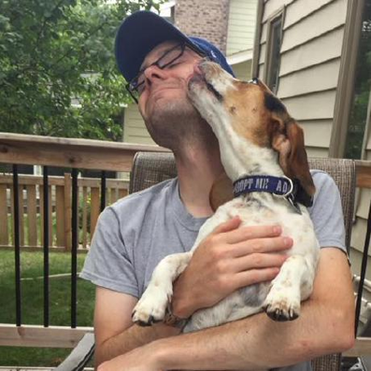

Inference via Convolutional Neural Network (CNN)
Infer presence of phenomenon of interest
Capture properties of genealogy with vector of statistcs
Lex Flagel
Sequence alignment
Photo credit: techcrunch.com

Slide 75
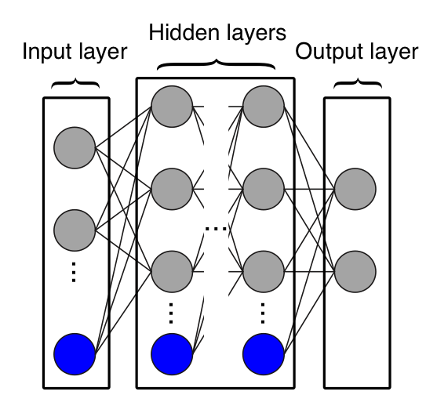
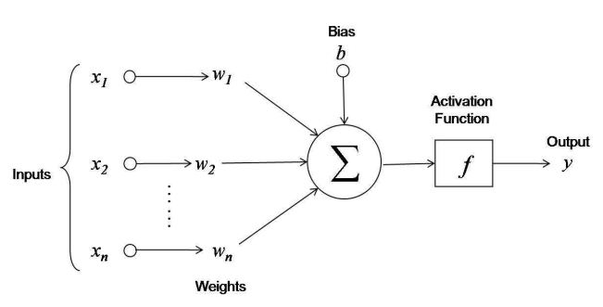
Artificial neural network

Slide 76
Convolutional filter layer
1 | 3 | 4 | 4
2 | 1 | 5 | 3
4 | 2 | 2 | 1
1 | 1 | 4 | 2
4 | 9 | 12
8 | 5 | 8
6 | 7 | 8
1 | 0
1 | 1
Filter
1*1 + 3*0 + 2*1 + 1*1 = 4
Input matrix
3*1 + 4*0 + 1*1 + 5*1 = 9
…
2*1 + 1*0 + 4*1 + 2*1 = 8

Slide 77
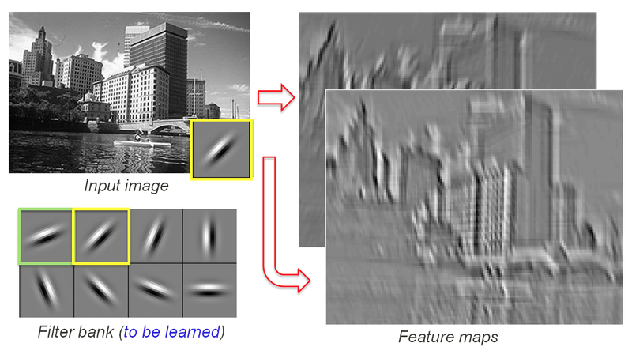
Convolutional filter layer
image made by Rob Fergus

Slide 78
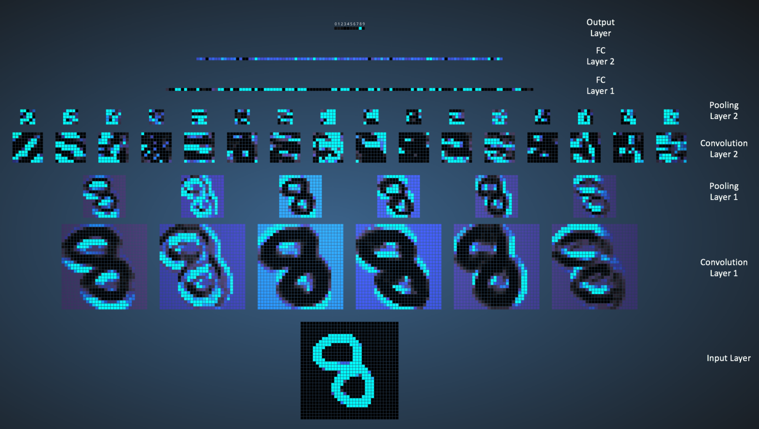
Convolutional Neural Network
image made by Ujjwal Karn using Adam Harley’s awesome interactive tool

Slide 79
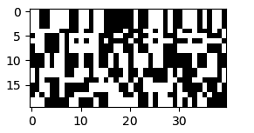
What if this is our input?
…
Samples
Genomic positions
What can we infer about a population sample’s evolutionary history using a CNN?

Slide 80
Finding Introgression via classification
Classifiers trained/tested on data simulated under D. simulans/sechellia demography
1) No introgression
2) D. sim→D. sech
3) D. sech→D. sim

Slide 81
CNN > FILET
Flagel et al. (2019; MBE)

Slide 82
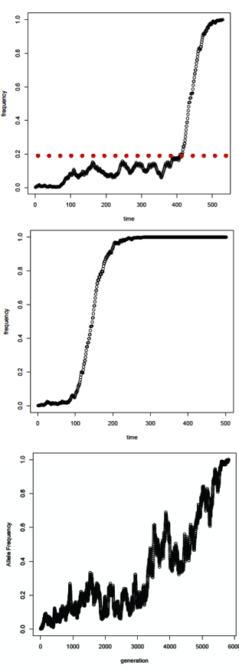
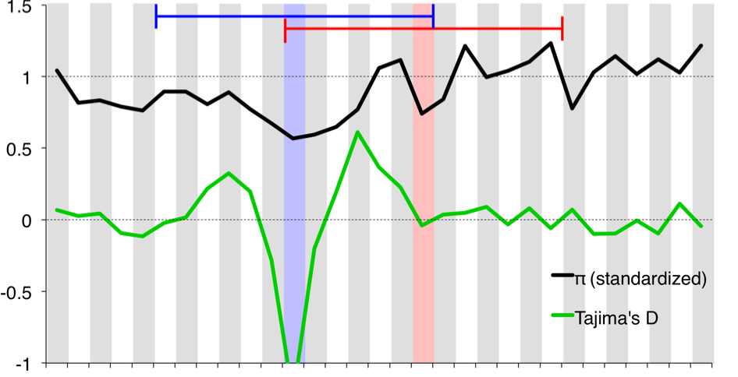


Classifying complete selective sweeps
11 windows x 11 statistics: 121 features!

Slide 83
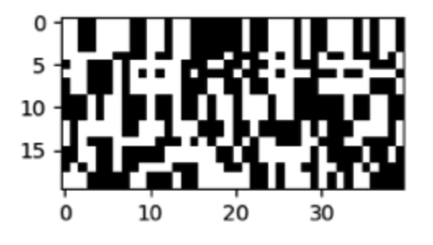

121 features vs. alignment image
Training and test simulations: JPT demog model from Auton et al. 2015
CNN
S/HIC
…

Slide 84
Inferring recombination rates
Simulations for training (CNN) and testing (both):
20 kb loci (human-ish parameters)
variable N_{e}
variable recombination rate
LDHat
CNN
Predicted recomb rate
True recomb rate
RMSE: 0.0160
R²: 0.768
True recomb rate
RMSE: 0.0126
R²: 0.862

Slide 85
Inferring rec rate in tetraploids
RMSE: 0.012
R²: 0.83

Slide 86
Inferring demographic parameters
N₀
N₀: ~U(100, 40000)
T₁: ~U(100, 3500)
N₁: ~U(100, 5000)
T₂: ~U(1, 3500) + T₁
N₂: ~U(100, 20000)
Population size
N₂
N₁
T₂
T₁
Present
Time

Slide 87
Inferring demographic parameters
Inference made from a single 1 Mb window
Need more data!

Slide 88
Conclusions (part 5)
1) CNNs can extract from alignments salient information for making inferences about evolutionary phenomena.
2) This approach can outperform summary statistics (even large vectors thereof) designed by experts for this purpose.
3) Extremely flexible: can be applied to any problem for which we can obtain training data (no stats required).
4) Practical challenges remain. (Optimal representation, optimal network architecture, handling large/many alignments, etc).

